Slide 1
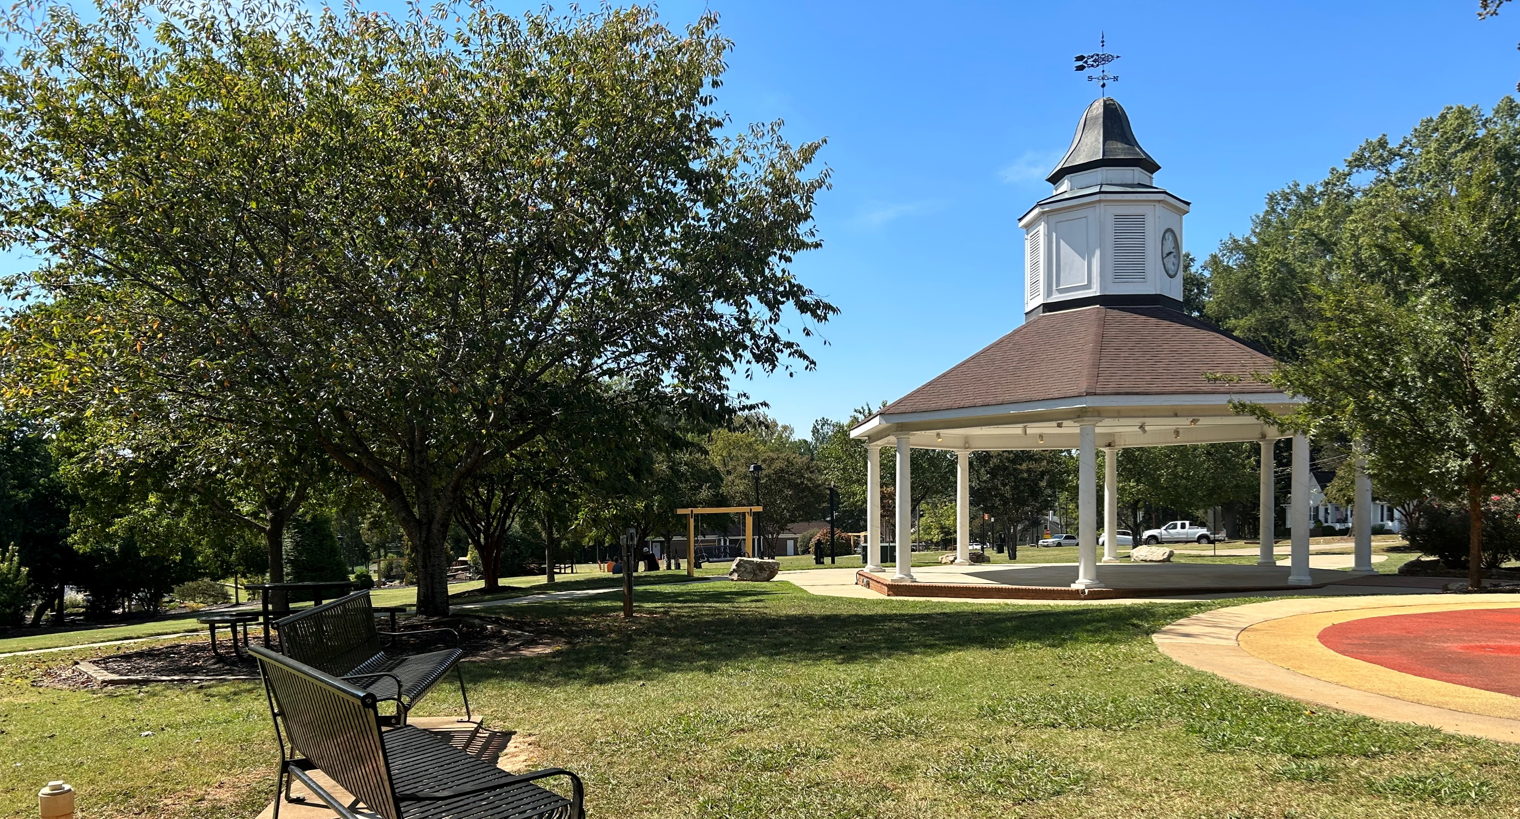
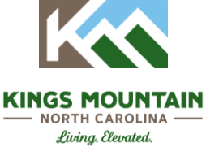
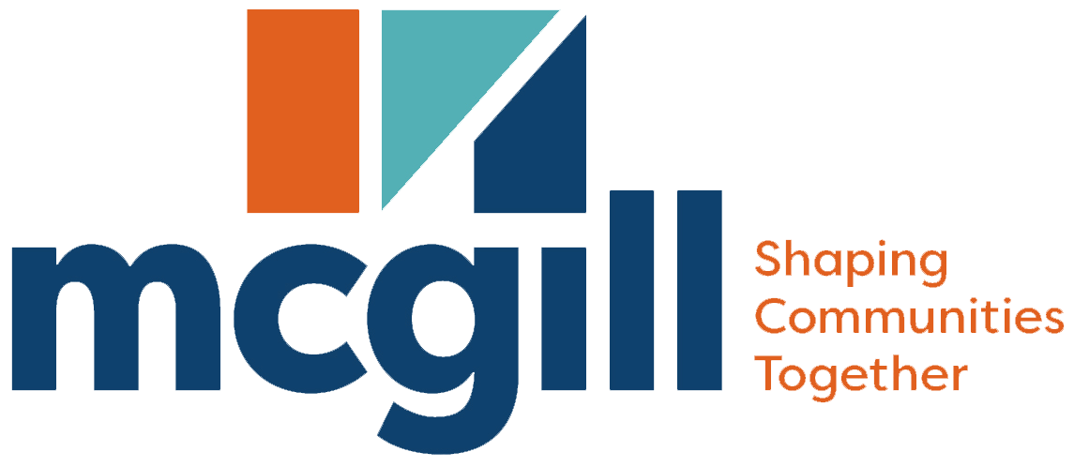
City of Kings Mountain Parks and Recreation Recreation and Parks Comprehensive Plan
Notes:
As an initial step in kicking off the process to develop a comprehensive plan for the Lincoln City/New Bern, we thought it would be appropriate to provide a primer on comprehensive planning and what it means for Wendell. In this brief presentation, we also aim to answer your questions about the process. We want you to know what to expect along the way. More importantly, we want to know about your expectations. So, at the end, we have a couple of questions for you, as we’d like to find out what you hope to accomplish with the process and/or the plan itself.

Slide 2
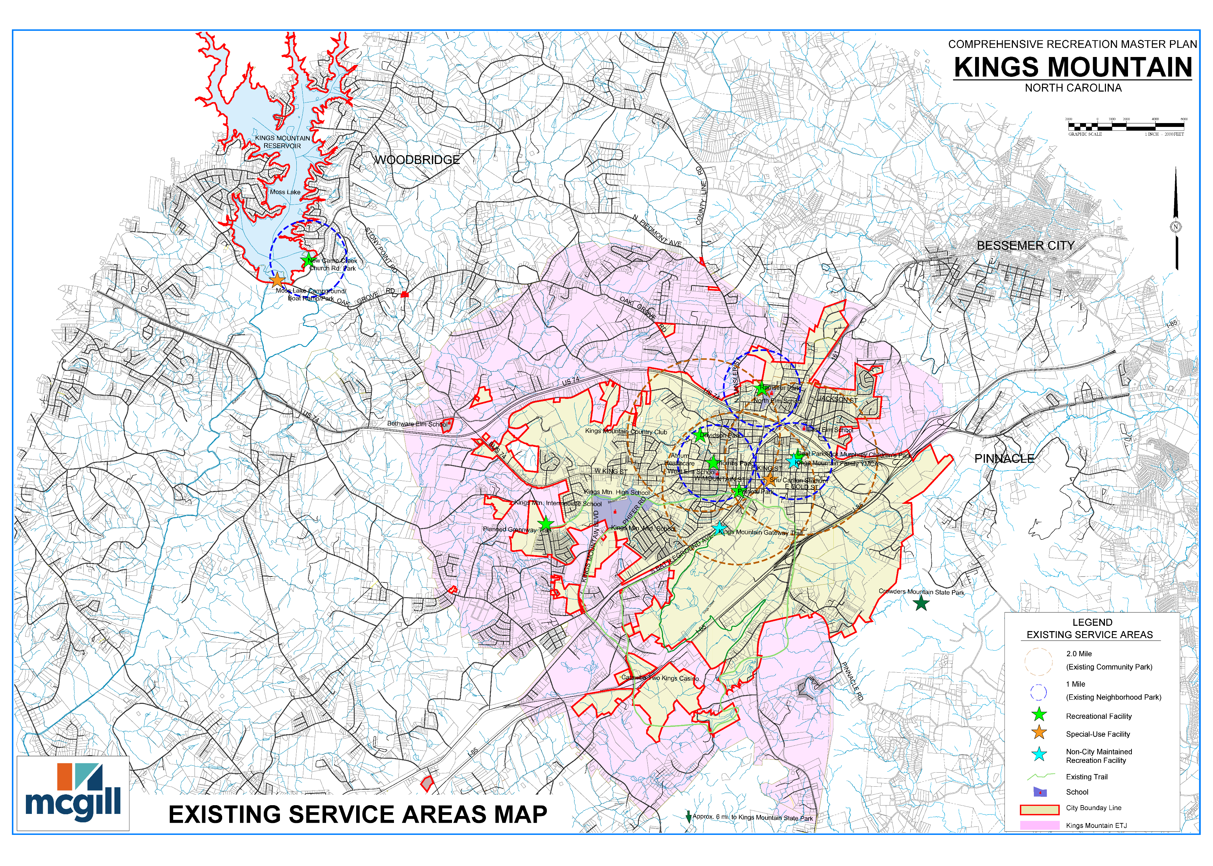
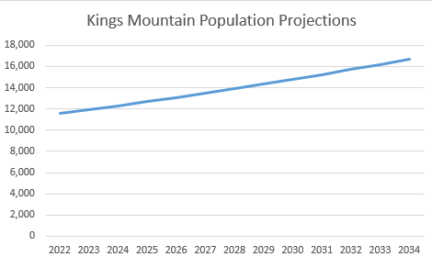
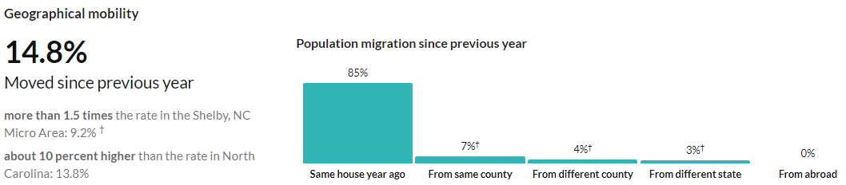
Existing conditions
Kings Mountain’s population is growing
Two significant drivers of growth: Mining and the Two Kings Casino
Limited number of recreation facilities and programs to serve this growing population
Population projections using NCOSBM Growth rates
Notes:
This presentation has 3 parts:
--an introduction to comprehensive planning
--an overview of the process
--and discussion questions

Slide 3


City Lakes #1 & #2
Davidson Park
Deal Park
LG Thombs Park
Moss Lake Recreation Facilities
New Camp Crk. Ch. Rd. Park
Patriot Park
Ramseur Park
Shu Carlton Stadium
Notes:
This presentation has 3 parts:
--an introduction to comprehensive planning
--an overview of the process
--and discussion questions

Slide 4
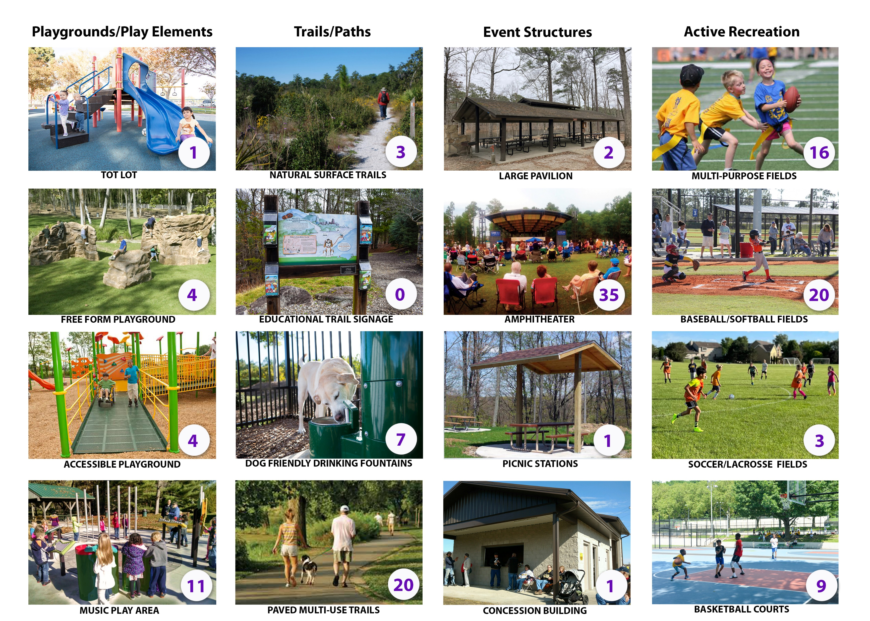
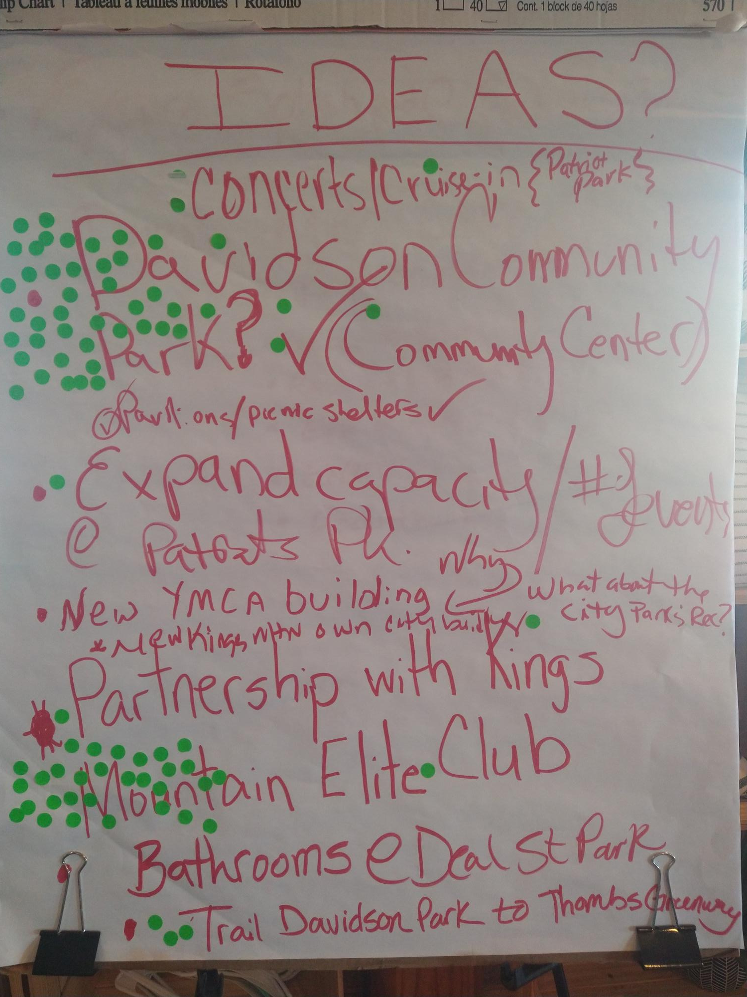
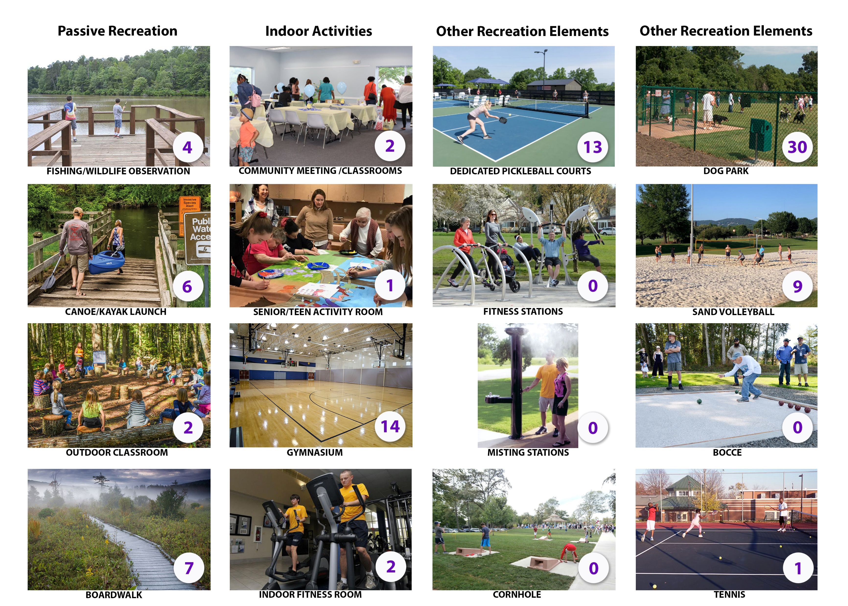
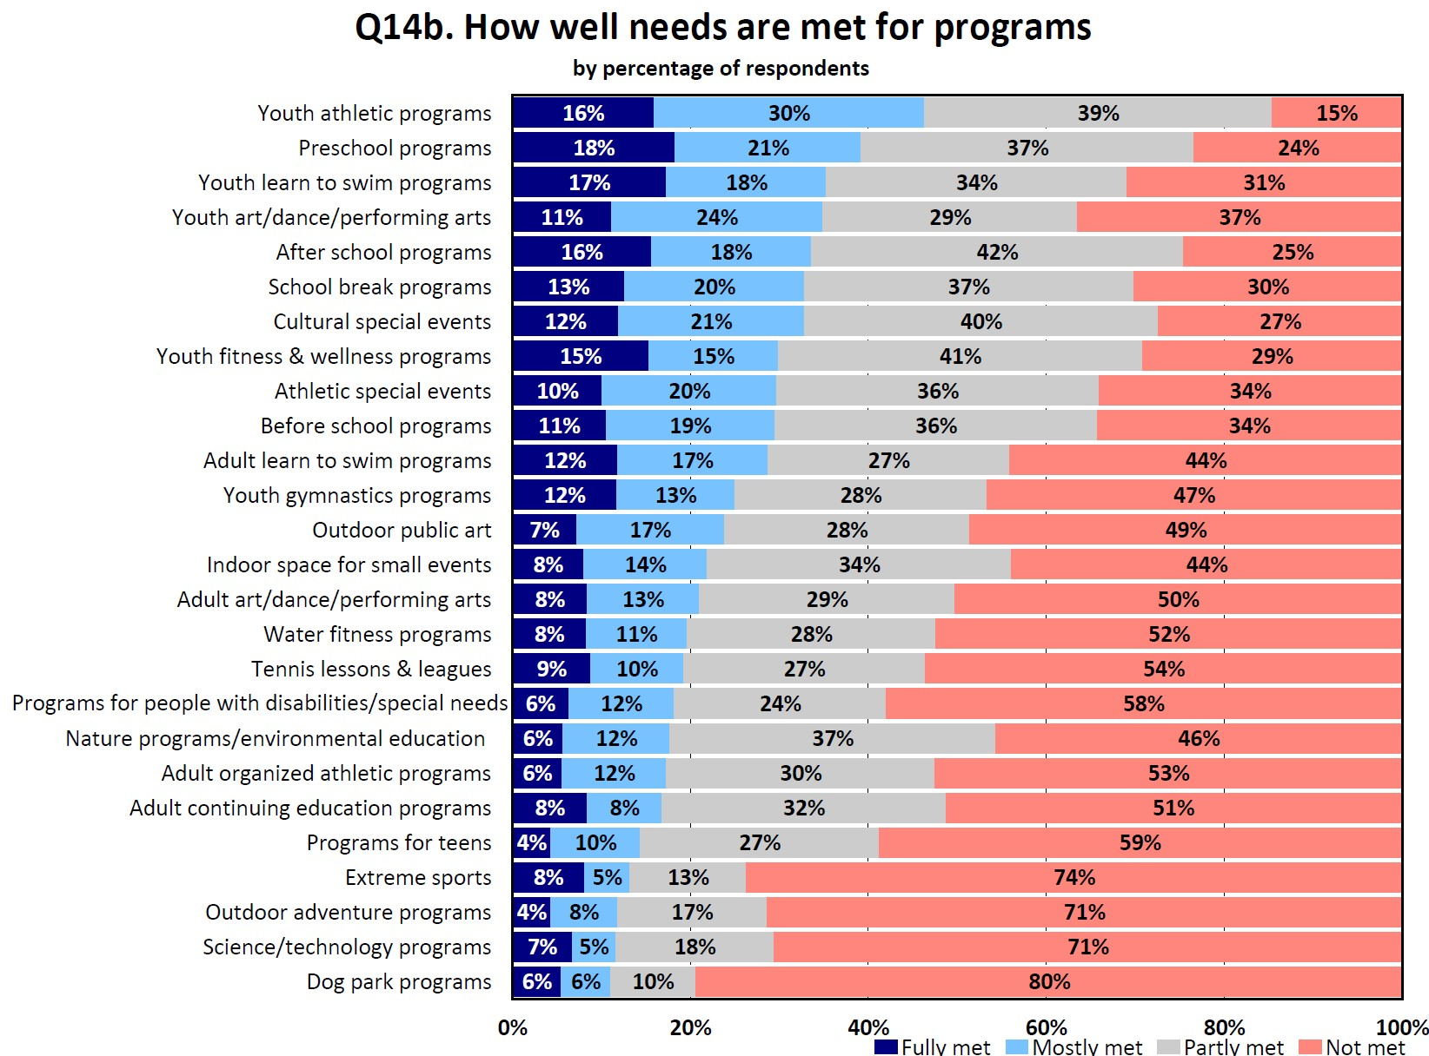
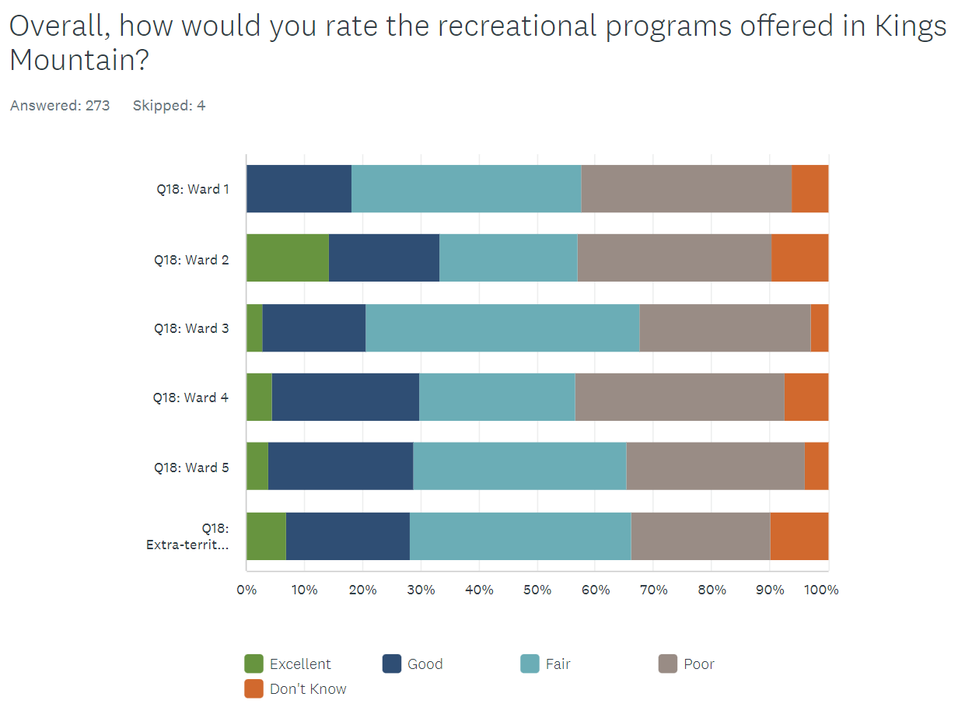
Multi-modal Input Methodology
4 Public Meetings
2 Public Surveys
6+ Focus Groups
Staff discussions
In-person Visual Preference Exercises
Open Input
Focus Group Noted: ______________ “Our parks can attract visitors and impact the local economy…”
Statistically Valid Survey
Open Survey
Notes:
We will conduct virtual meetings, including some that offer live presentations along with live polling and chats.
Pre-recorded presentations, like this one, can be accompanied by brief surveys so we can share information and get the feedback we need.
But how do we reach folks who do not have internet access?
The City will utilize other means. For example, staff will reach out with paper surveys that can be mailed back to the City. Also, the City will encourage and facilitate the use of apps like Nextdoor and tap into public school and church communications.

Slide 5
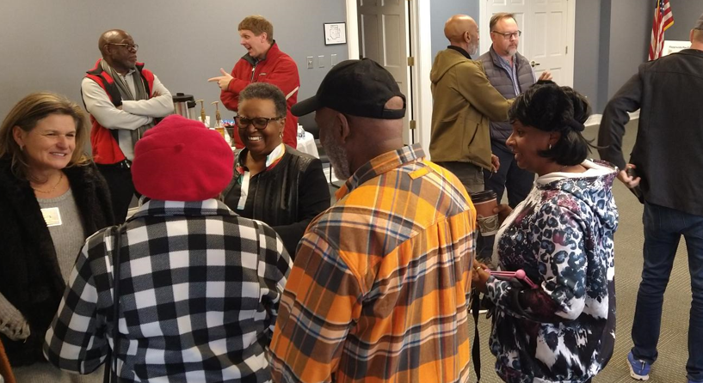
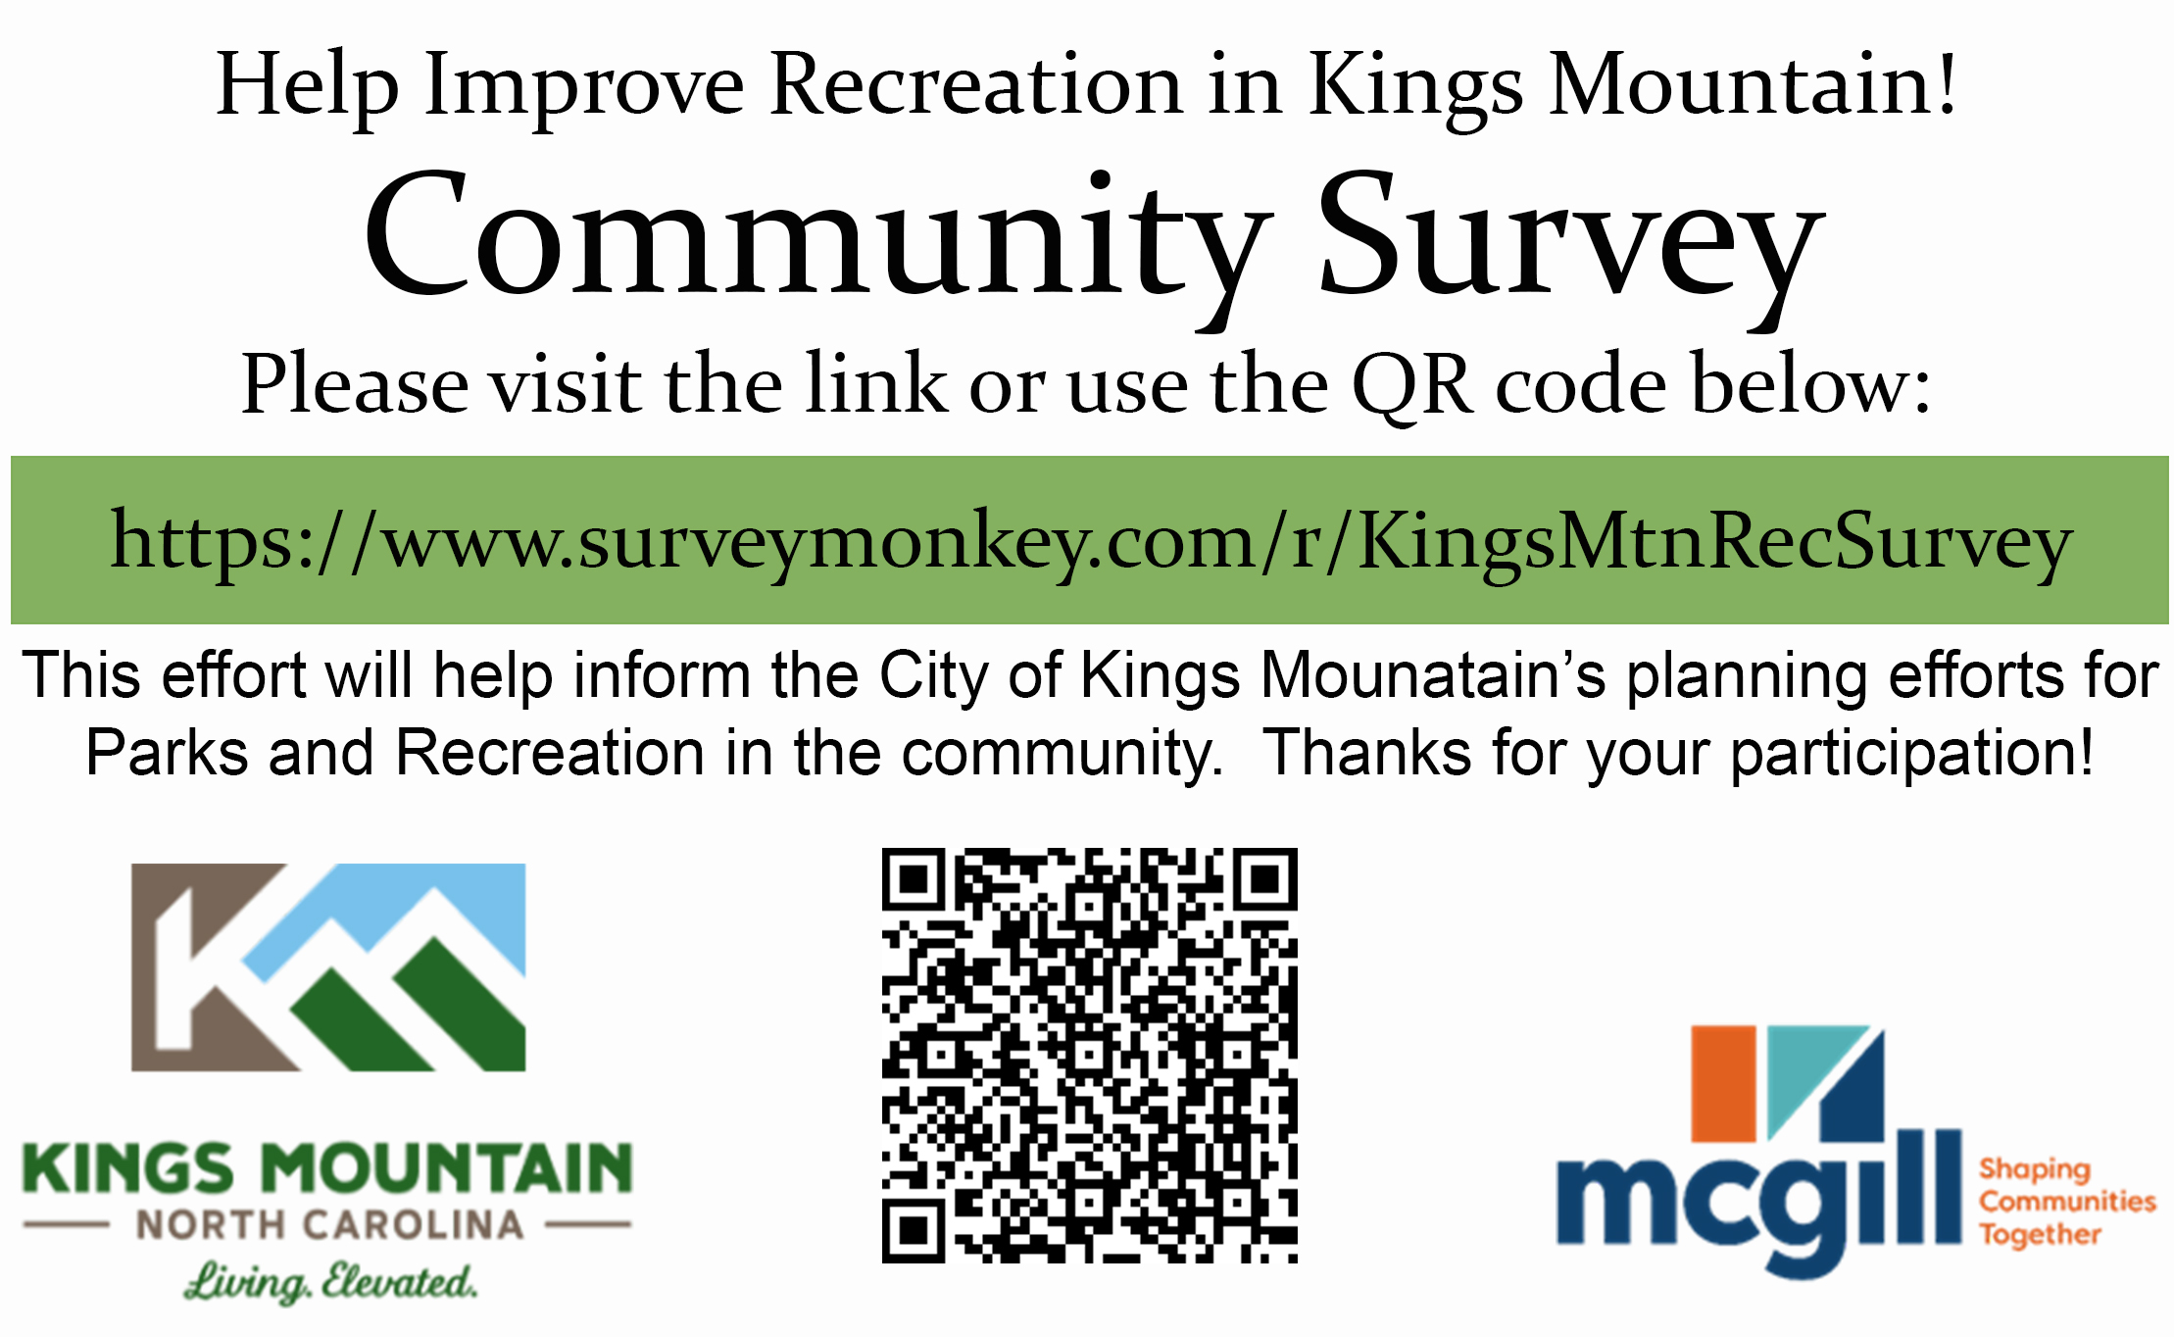
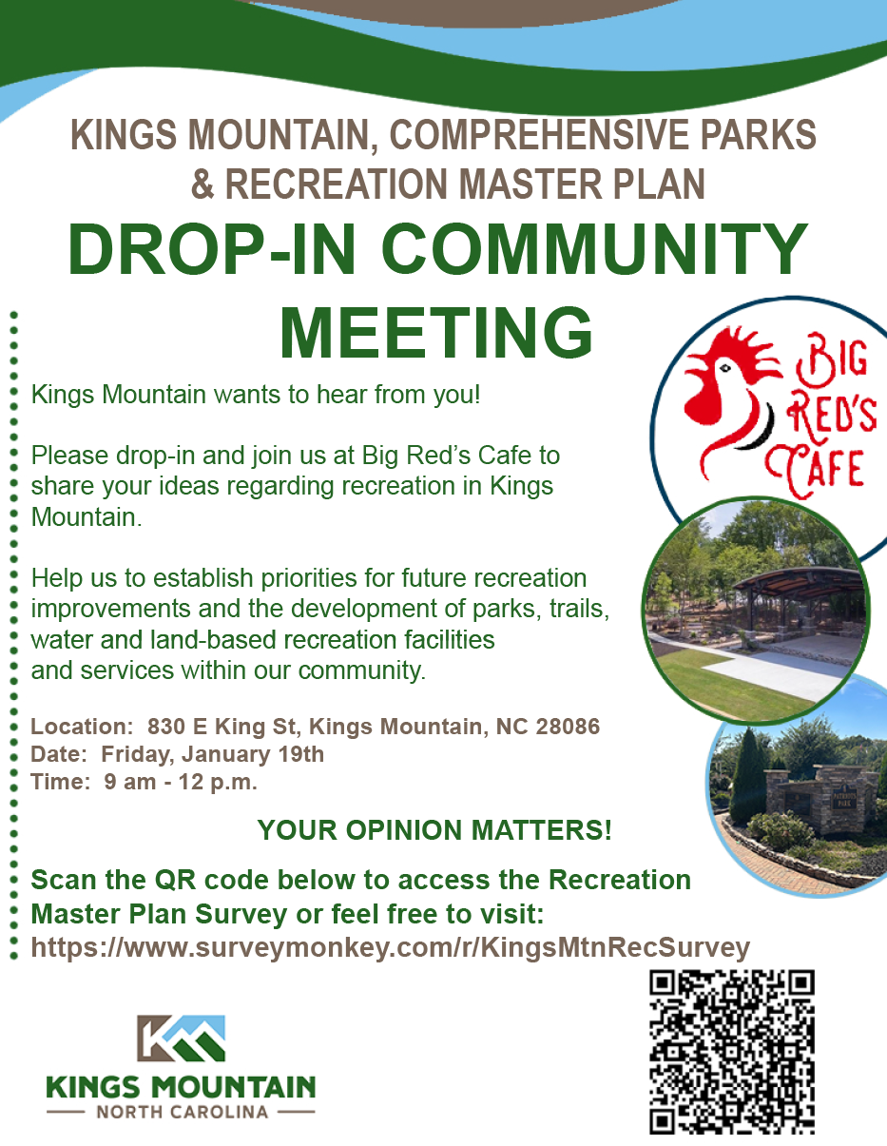
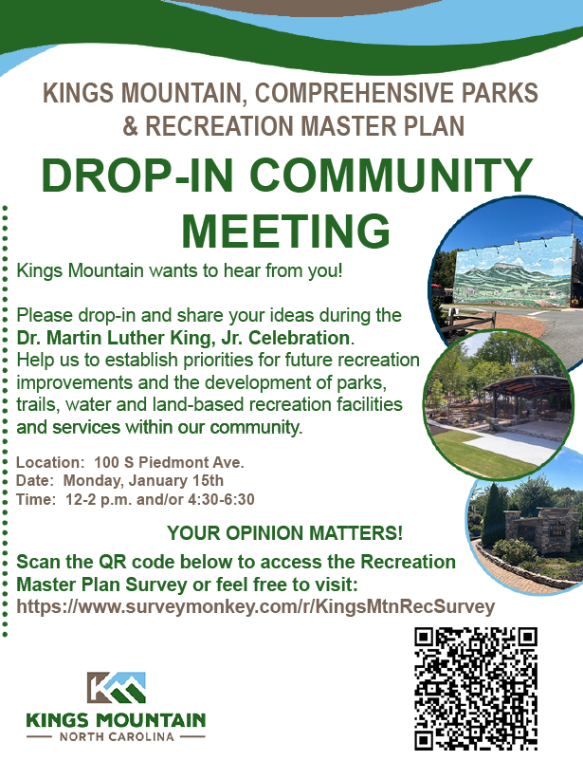
Reaching the Community
Strong public response via;
3 public meetings were held on January 15th from 12 pm to 2:30 pm (Library)
January 15th from 4 pm to 6:30 pm (Library)
January 19th from 9 am to 12 pm (Big Red’s Café)
City staff hosted an additional community drop-in meeting
at the Imperial Mercantile 3-6 pm 2.9.24
Approximately 110 participants joined a public input event.
Five Focus Group Meetings Feb. 21st & Feb. 22nd
Citizens Group 9-10 am
Trails 10:30-11:30 am
Parks/Recreation 1-2 pm
Moss Lake Commission 2:30-3:30 pm (no participants)
Non-profits/Athletic Groups 4-5 pm
Inter-Government (2.22) 4-5 pm
(Individual Interviews – w/Rick Duncan & Jim Palenick)
Notes:
This presentation has 3 parts:
--an introduction to comprehensive planning
--an overview of the process
--and discussion questions

Slide 6
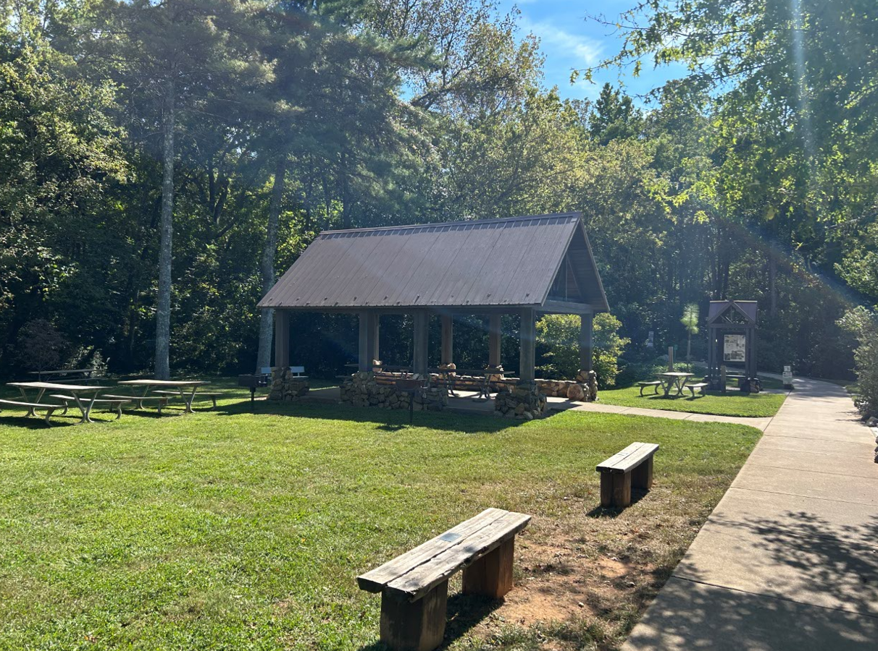
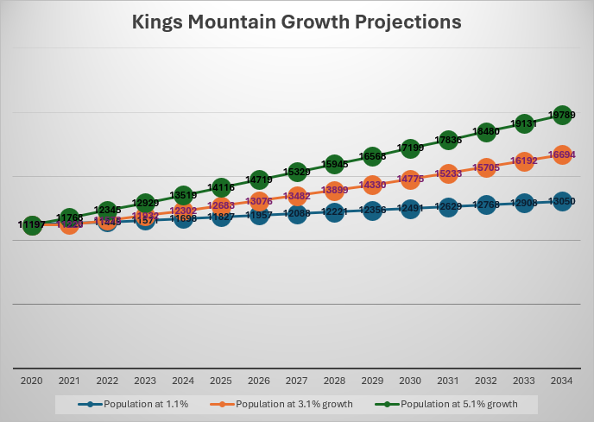
Reaching the Community
Kings Mountain has a growing population and is planning to meet this growth-based demand.
2022 Population: 11,492
2034 Anticipated Population: 16,694 (3.1% AGR)
A statistically valid survey was mailed on Feb. 1st
305 surveys collected with a 95% level of confidence.
Open to Everyone Survey:
Participation was strong, with 354 respondents
representing over 761 individuals in the community. (Appx. 6.6% of the total population)
Notes:
This presentation has 3 parts:
--an introduction to comprehensive planning
--an overview of the process
--and discussion questions

Slide 7
The benefits of
Statistically Valid Surveys
Conducted using academic methods
Limited survey bias
Demographic representative
Valid for getting grant funding
Why two surveys?
The benefits of an
Open Survey
Anyone can take it
Can collect visitor information
Can understand geographic variations
Valid for getting grant funding (with a high enough response rate…which you have)
Refined &
Concise
YOU PINPOINT NEED
Robust
& Descriptive
Both can work for grant funding
The drawback Only about 300 people get to take the survey Cost
The drawback
(Risk of sampling bias)
To get the best of both worlds
Notes:
This presentation has 3 parts:
--an introduction to comprehensive planning
--an overview of the process
--and discussion questions

Slide 8
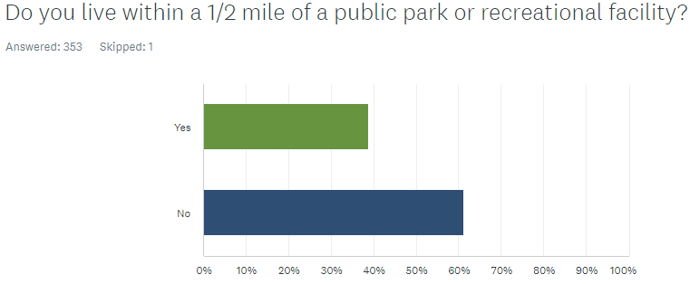
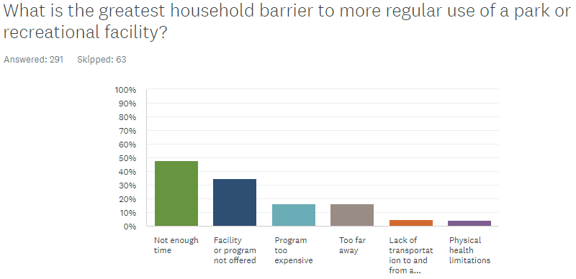
Open to Everyone Survey Findings
Top 15 Requested Facilities
Outdoor Playground
Walking and Jogging Trails
Open & Natural Areas
Hiking Trails
Community Recreation Center
Outdoor/Indoor Swimming Pool
Splash Pad
Picnic Areas
Dog Park
Multi-Sports Complex
Performing Arts Center
Outdoor Performance Areas
Teen Center
Outdoor Track
Baseball/Softball Fields
Notes:
This presentation has 3 parts:
--an introduction to comprehensive planning
--an overview of the process
--and discussion questions

Slide 9
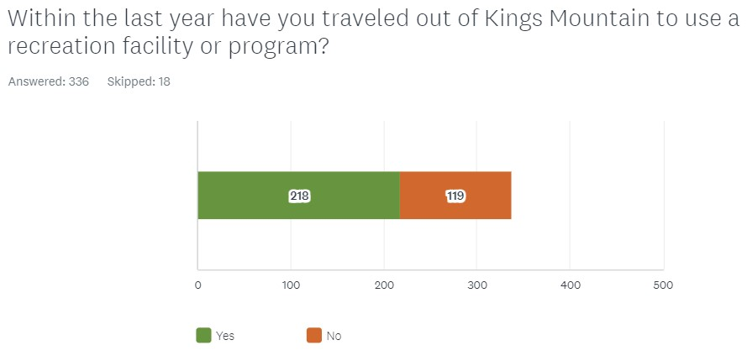
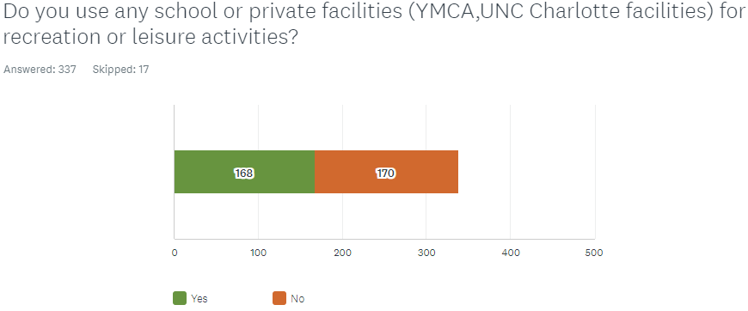
What are the needs expressed by the survey participants?
Notes:
This presentation has 3 parts:
--an introduction to comprehensive planning
--an overview of the process
--and discussion questions

Slide 10
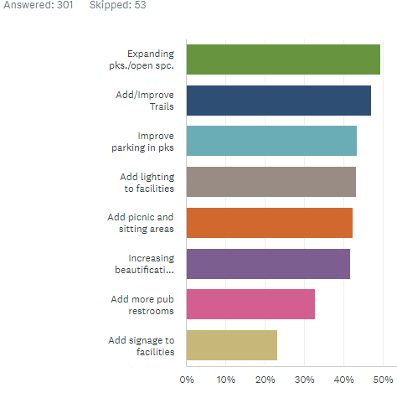
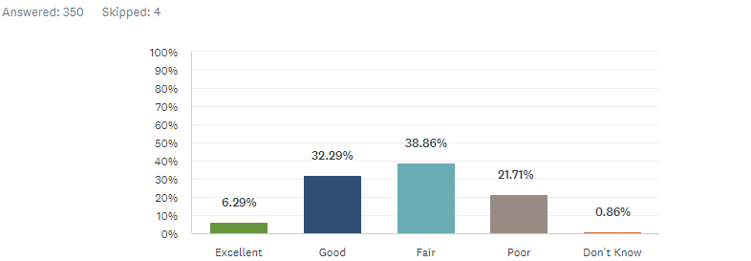
What are the needs expressed by the survey participants?
Desired improvements at
Existing Kings Mountain parks
Most Visited Facilities
30% report using Patriot Park
21% report using Kings Mountain Gateway Trail
Participant rating of existing Kings Mountain parks
Notes:
This presentation has 3 parts:
--an introduction to comprehensive planning
--an overview of the process
--and discussion questions

Slide 11
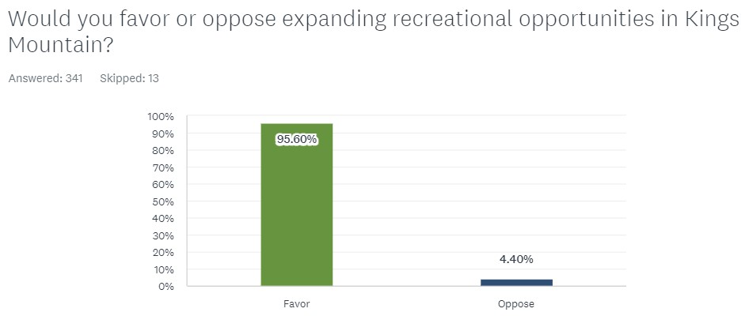
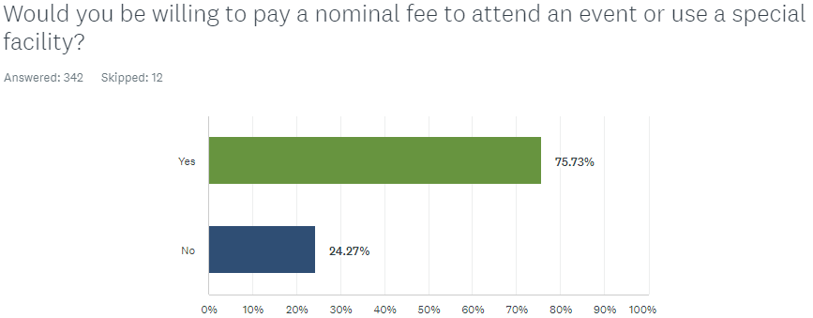
What are the needs expressed by the survey participants?
Notes:
This presentation has 3 parts:
--an introduction to comprehensive planning
--an overview of the process
--and discussion questions

Slide 12
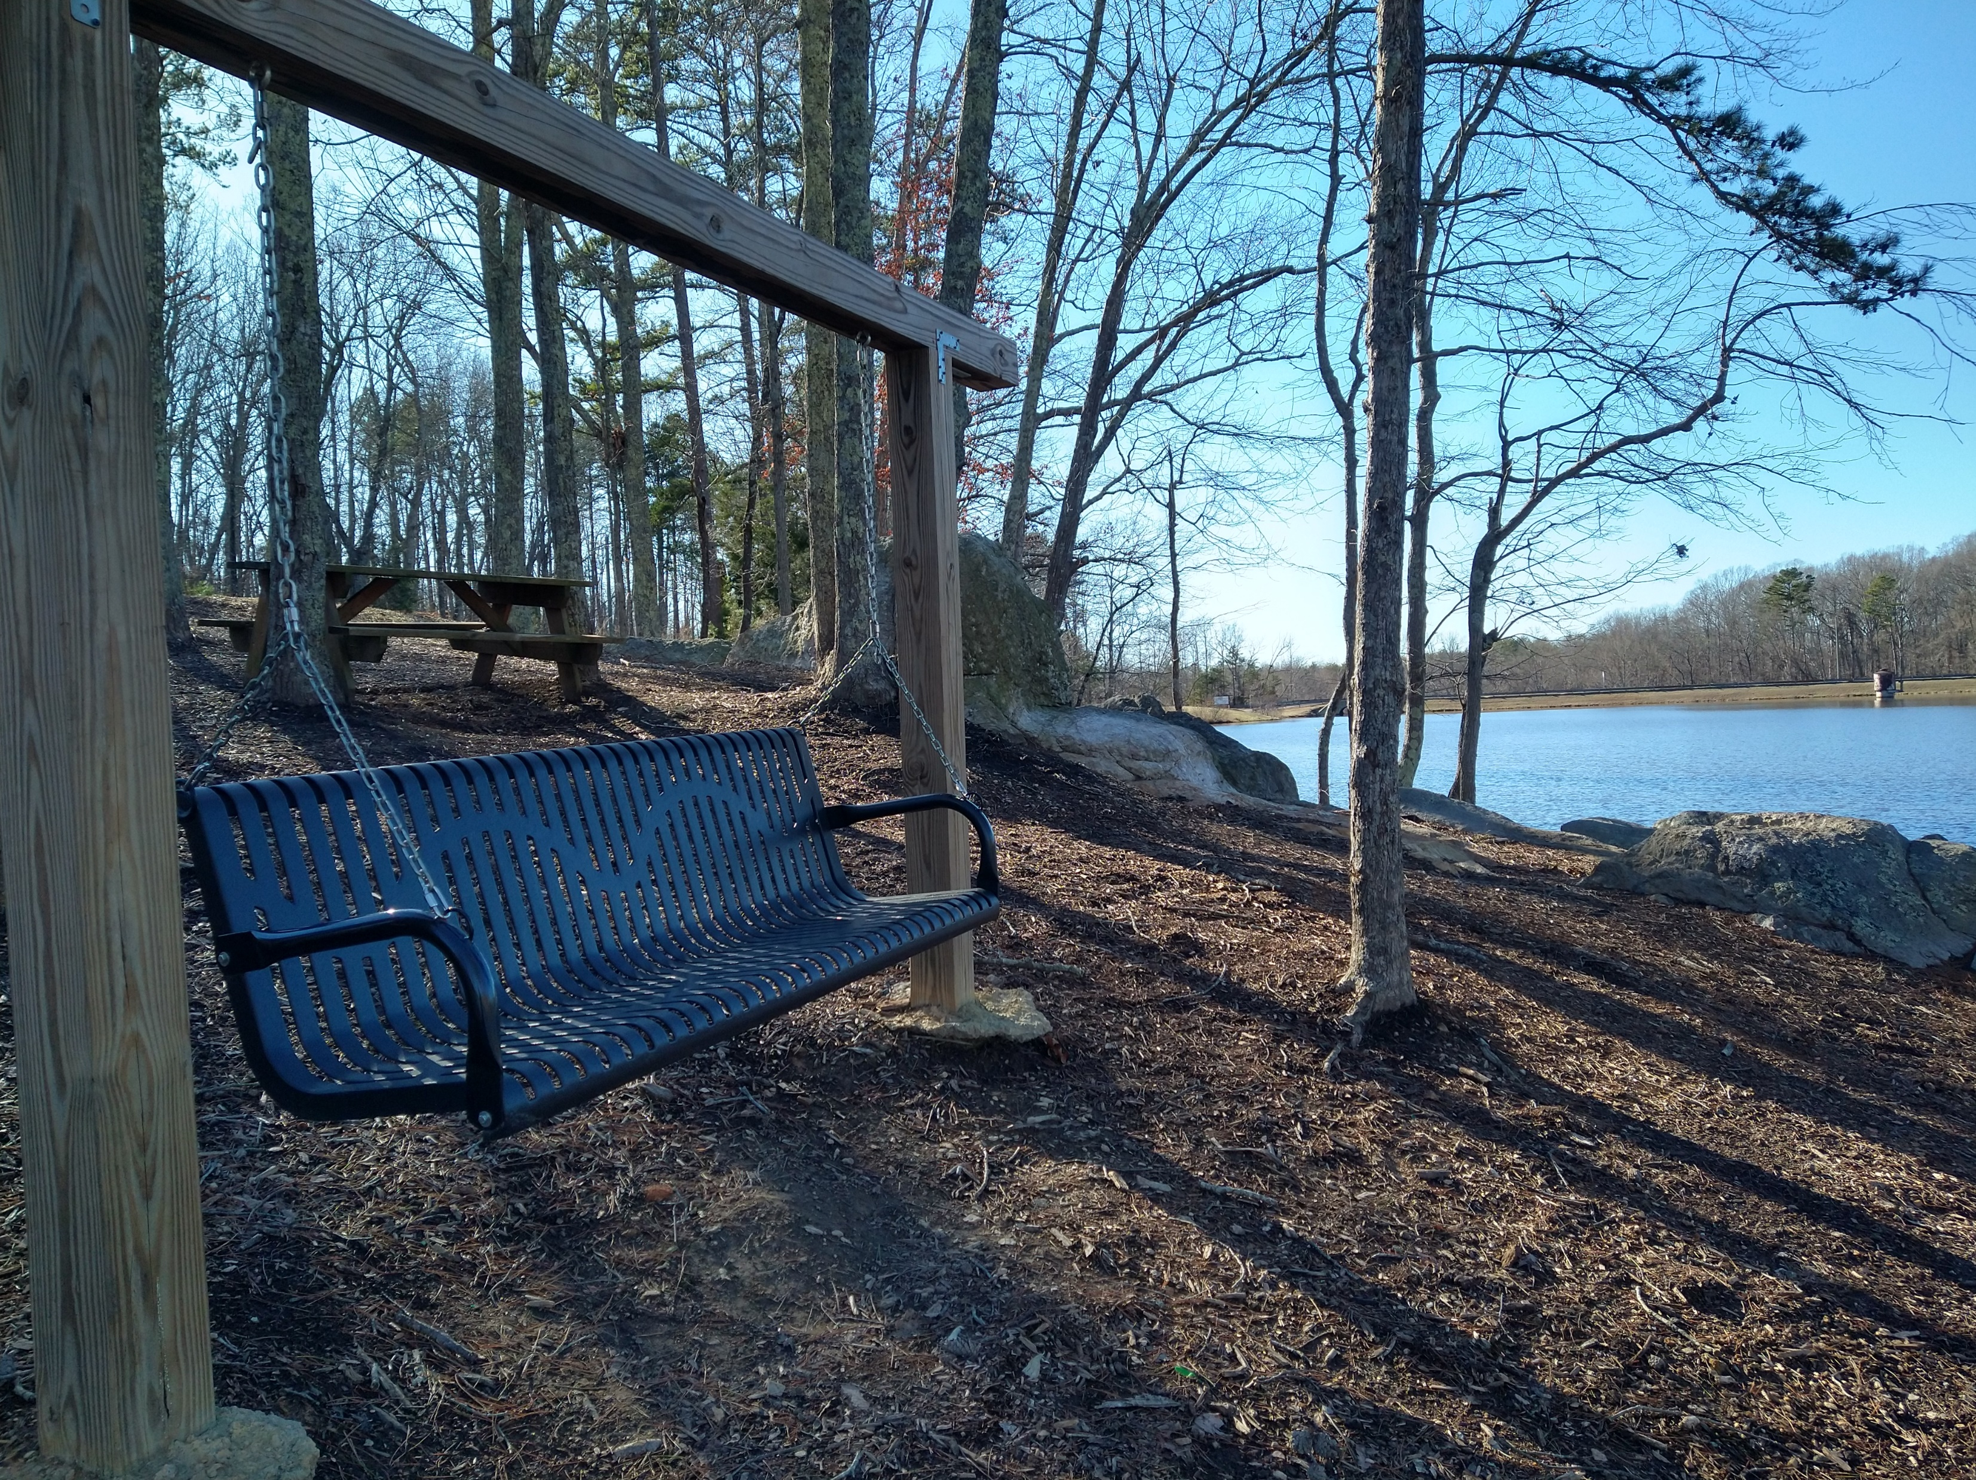
Key Overarching Findings: Open Survey
Residents:
More than half of survey takers don’t use schools or private facilities.
64%+ of residents' report having traveled outside of Kings Mountain for recreation facilities or programs in the last year
95%+ support expanding recreation opportunities.
Notes:
There are about 6 objectives of all community planning processes and the resulting plans that we consider benefits to the community:
The first is framing the issues and opportunities. By defining them, we can create a “snapshot” of what’s happening today so everyone can move forward with purpose.
We can then focus on what we want for the future of the community. We need a clear view of that future condition. We can all move in the same direction if we’re working toward a shared vision.
The plan, which will have detailed recommendations and implementation strategies, should serve as a guide in all decision making. This is especially important when City leaders are faced with decisions about development approvals and the use of tax revenue for capital investments, such as utilities to support desired development or parks and other public amenities to improve the quality of life in the community.
The plan should also have everyone singing from the same sheet of music, so to speak. By communicating what the community wants and how to achieve it, all department and partner agencies can coordinate efforts to maximize available resources.
When pursuing grants, the adopted plan can increase chances of obtaining funding. It can strengthen the application by demonstrating the City’s commitment to specific improvements.
And, finally, the plan is a step toward compliance with State statutes… among other things, an up-to-date plan is required as a foundation for local land development regulations, such as zoning. Soon, the City will be subject to the new requirements of 160D.

Slide 13
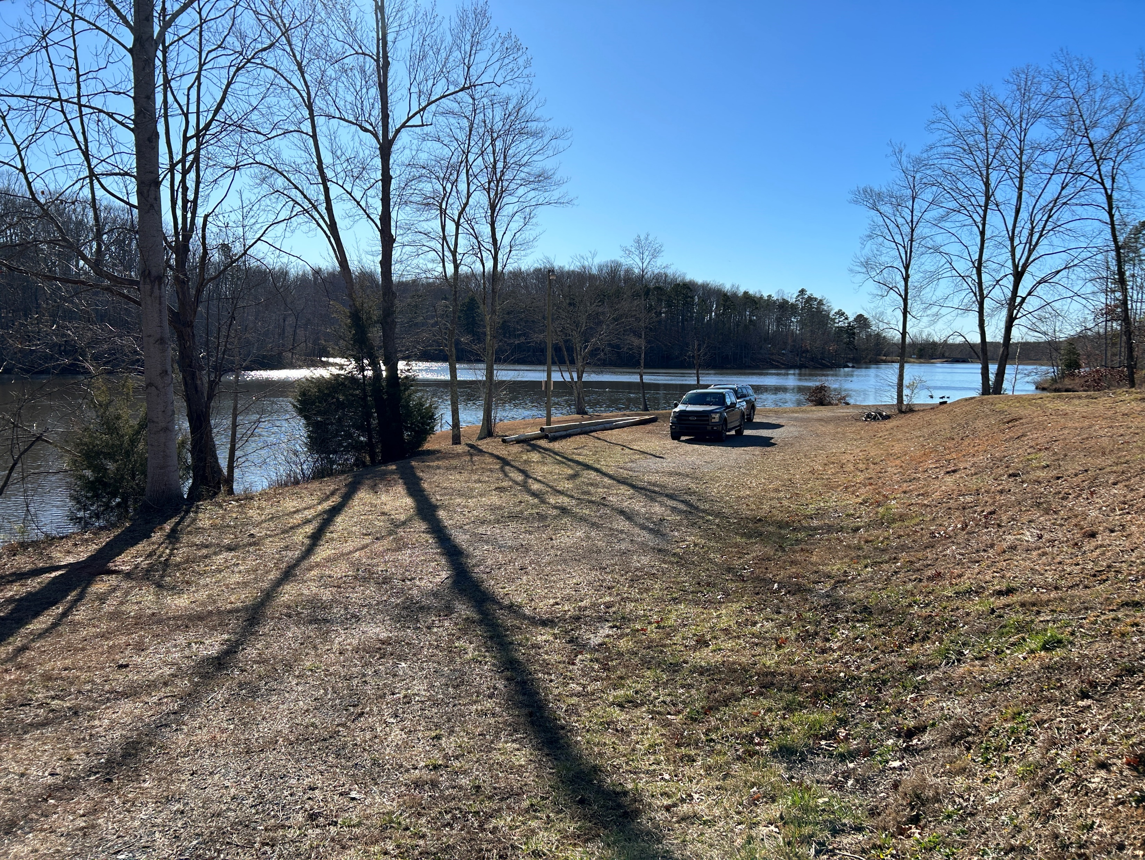
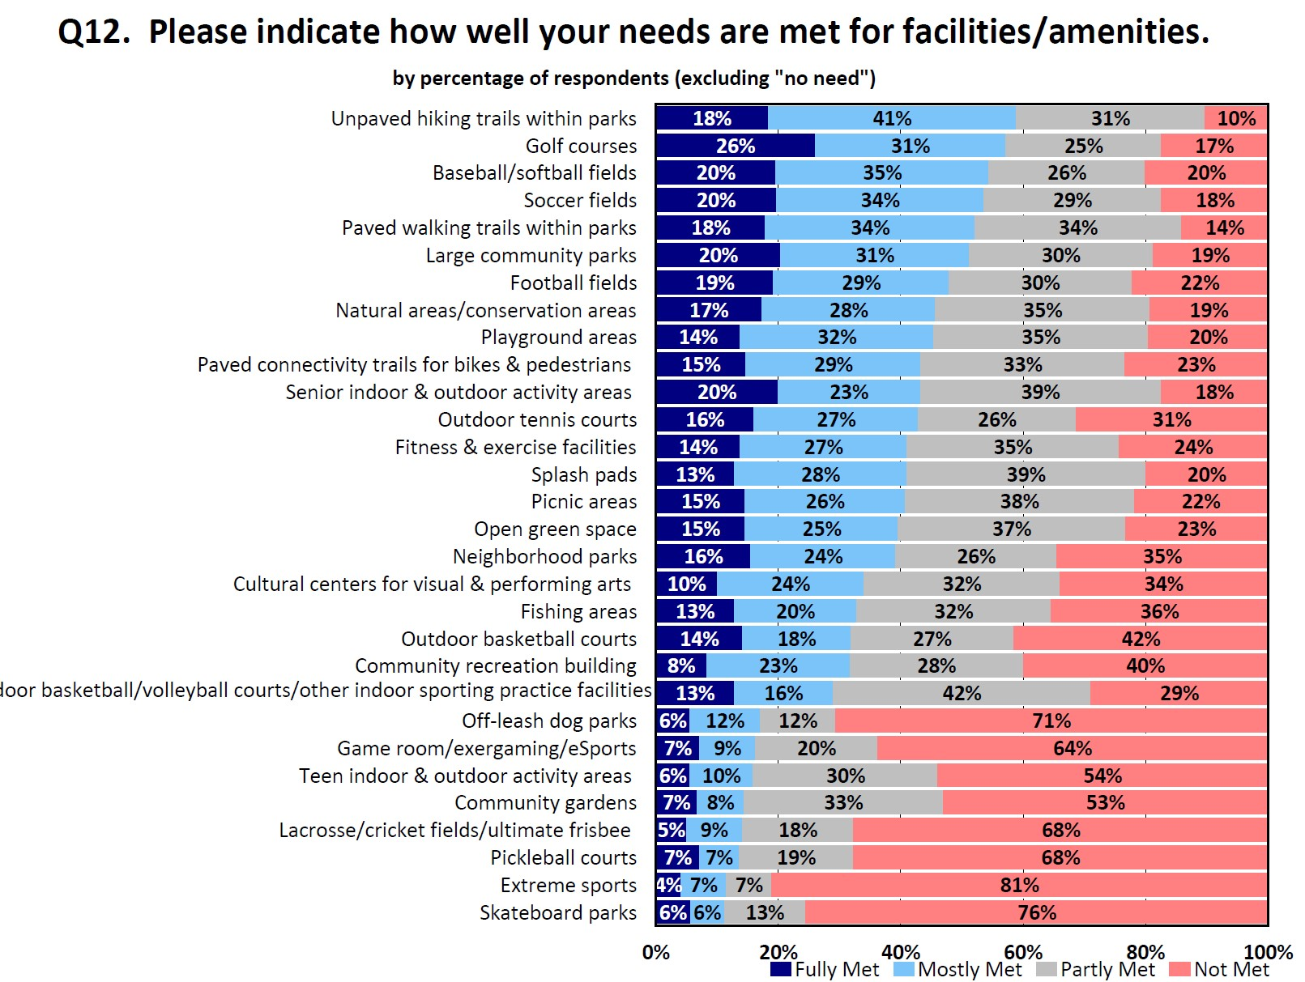
Statistically Valid Survey Findings (305 surveys)
Residents:
There are significant levels of unmet needs for programs and facilities.
Only 36% of survey takers were satisfied or very satisfied with the value of recreation services in the City
Notes:
There are about 6 objectives of all community planning processes and the resulting plans that we consider benefits to the community:
The first is framing the issues and opportunities. By defining them, we can create a “snapshot” of what’s happening today so everyone can move forward with purpose.
We can then focus on what we want for the future of the community. We need a clear view of that future condition. We can all move in the same direction if we’re working toward a shared vision.
The plan, which will have detailed recommendations and implementation strategies, should serve as a guide in all decision making. This is especially important when City leaders are faced with decisions about development approvals and the use of tax revenue for capital investments, such as utilities to support desired development or parks and other public amenities to improve the quality of life in the community.
The plan should also have everyone singing from the same sheet of music, so to speak. By communicating what the community wants and how to achieve it, all department and partner agencies can coordinate efforts to maximize available resources.
When pursuing grants, the adopted plan can increase chances of obtaining funding. It can strengthen the application by demonstrating the City’s commitment to specific improvements.
And, finally, the plan is a step toward compliance with State statutes… among other things, an up-to-date plan is required as a foundation for local land development regulations, such as zoning. Soon, the City will be subject to the new requirements of 160D.

Slide 14

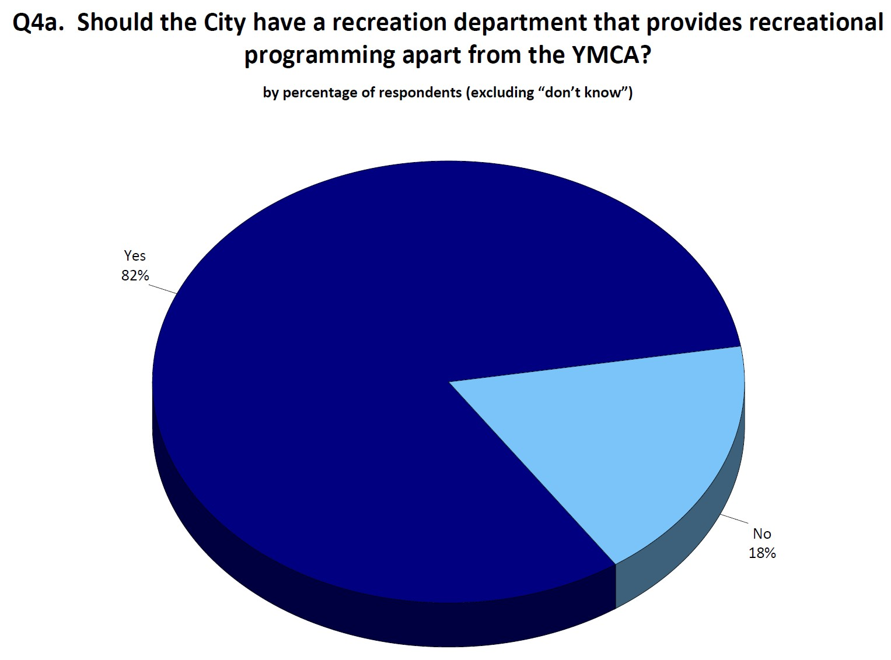
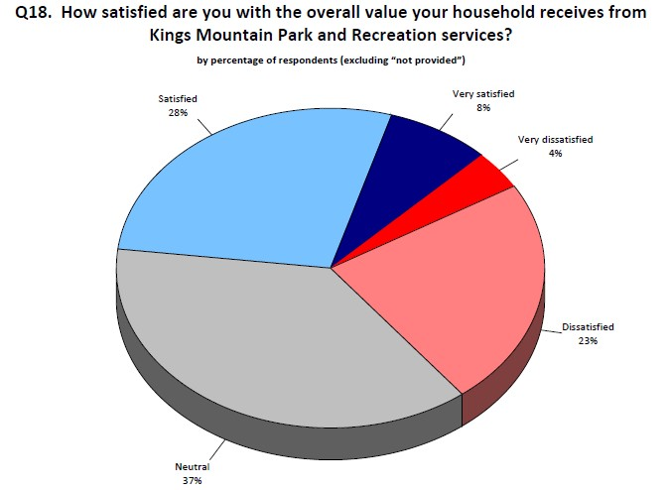
Key Overarching Findings: Statistically Valid cont.
High levels, over 25%, dissatisfaction/very dissatisfied exist
82% indicated wanting recreational programing apart from the YMCA
The largest portion of survey takers were neutral about overall value of recreation in Kings Mountain
Notes:
There are about 6 objectives of all community planning processes and the resulting plans that we consider benefits to the community:
The first is framing the issues and opportunities. By defining them, we can create a “snapshot” of what’s happening today so everyone can move forward with purpose.
We can then focus on what we want for the future of the community. We need a clear view of that future condition. We can all move in the same direction if we’re working toward a shared vision.
The plan, which will have detailed recommendations and implementation strategies, should serve as a guide in all decision making. This is especially important when City leaders are faced with decisions about development approvals and the use of tax revenue for capital investments, such as utilities to support desired development or parks and other public amenities to improve the quality of life in the community.
The plan should also have everyone singing from the same sheet of music, so to speak. By communicating what the community wants and how to achieve it, all department and partner agencies can coordinate efforts to maximize available resources.
When pursuing grants, the adopted plan can increase chances of obtaining funding. It can strengthen the application by demonstrating the City’s commitment to specific improvements.
And, finally, the plan is a step toward compliance with State statutes… among other things, an up-to-date plan is required as a foundation for local land development regulations, such as zoning. Soon, the City will be subject to the new requirements of 160D.

Slide 15
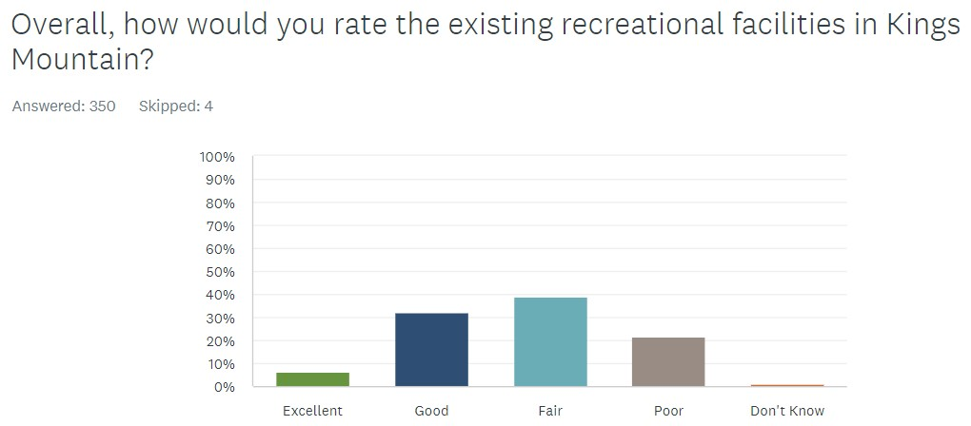
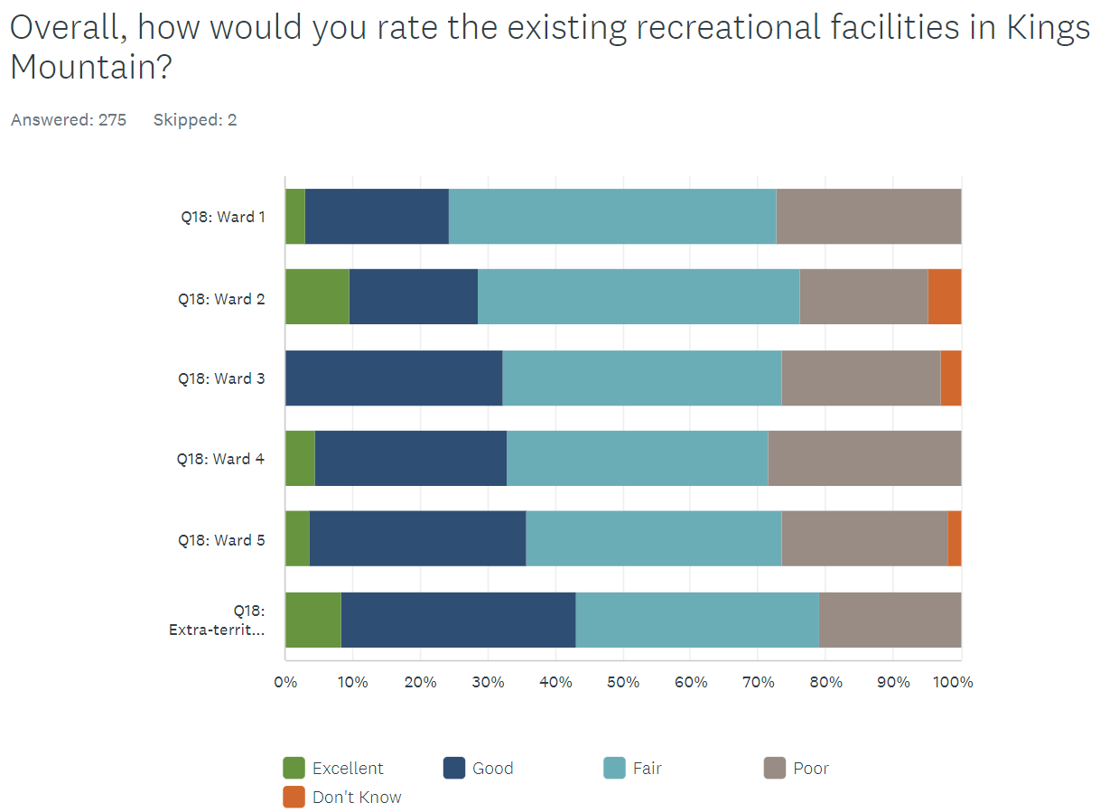
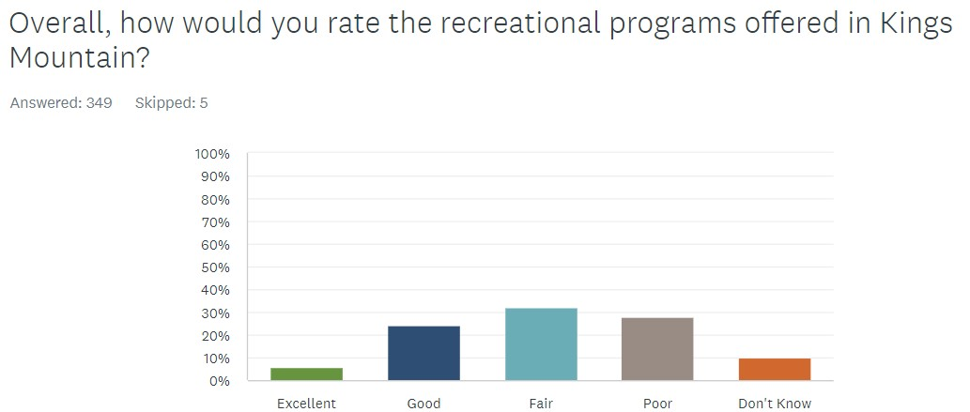
Key Overarching Findings: Open survey
Findings are similar in the open survey
Notes:
There are about 6 objectives of all community planning processes and the resulting plans that we consider benefits to the community:
The first is framing the issues and opportunities. By defining them, we can create a “snapshot” of what’s happening today so everyone can move forward with purpose.
We can then focus on what we want for the future of the community. We need a clear view of that future condition. We can all move in the same direction if we’re working toward a shared vision.
The plan, which will have detailed recommendations and implementation strategies, should serve as a guide in all decision making. This is especially important when City leaders are faced with decisions about development approvals and the use of tax revenue for capital investments, such as utilities to support desired development or parks and other public amenities to improve the quality of life in the community.
The plan should also have everyone singing from the same sheet of music, so to speak. By communicating what the community wants and how to achieve it, all department and partner agencies can coordinate efforts to maximize available resources.
When pursuing grants, the adopted plan can increase chances of obtaining funding. It can strengthen the application by demonstrating the City’s commitment to specific improvements.
And, finally, the plan is a step toward compliance with State statutes… among other things, an up-to-date plan is required as a foundation for local land development regulations, such as zoning. Soon, the City will be subject to the new requirements of 160D.

Slide 16
Expressed Needs: Major Themes
Playgrounds
More parks
Open space
Arts and Cultural Programs
Special events
Trails
Indoor programs
Water Access
Fitness Facilities
Notes:
We will conduct virtual meetings, including some that offer live presentations along with live polling and chats.
Pre-recorded presentations, like this one, can be accompanied by brief surveys so we can share information and get the feedback we need.
But how do we reach folks who do not have internet access?
The City will utilize other means. For example, staff will reach out with paper surveys that can be mailed back to the City. Also, the City will encourage and facilitate the use of apps like Nextdoor and tap into public school and church communications.

Slide 17
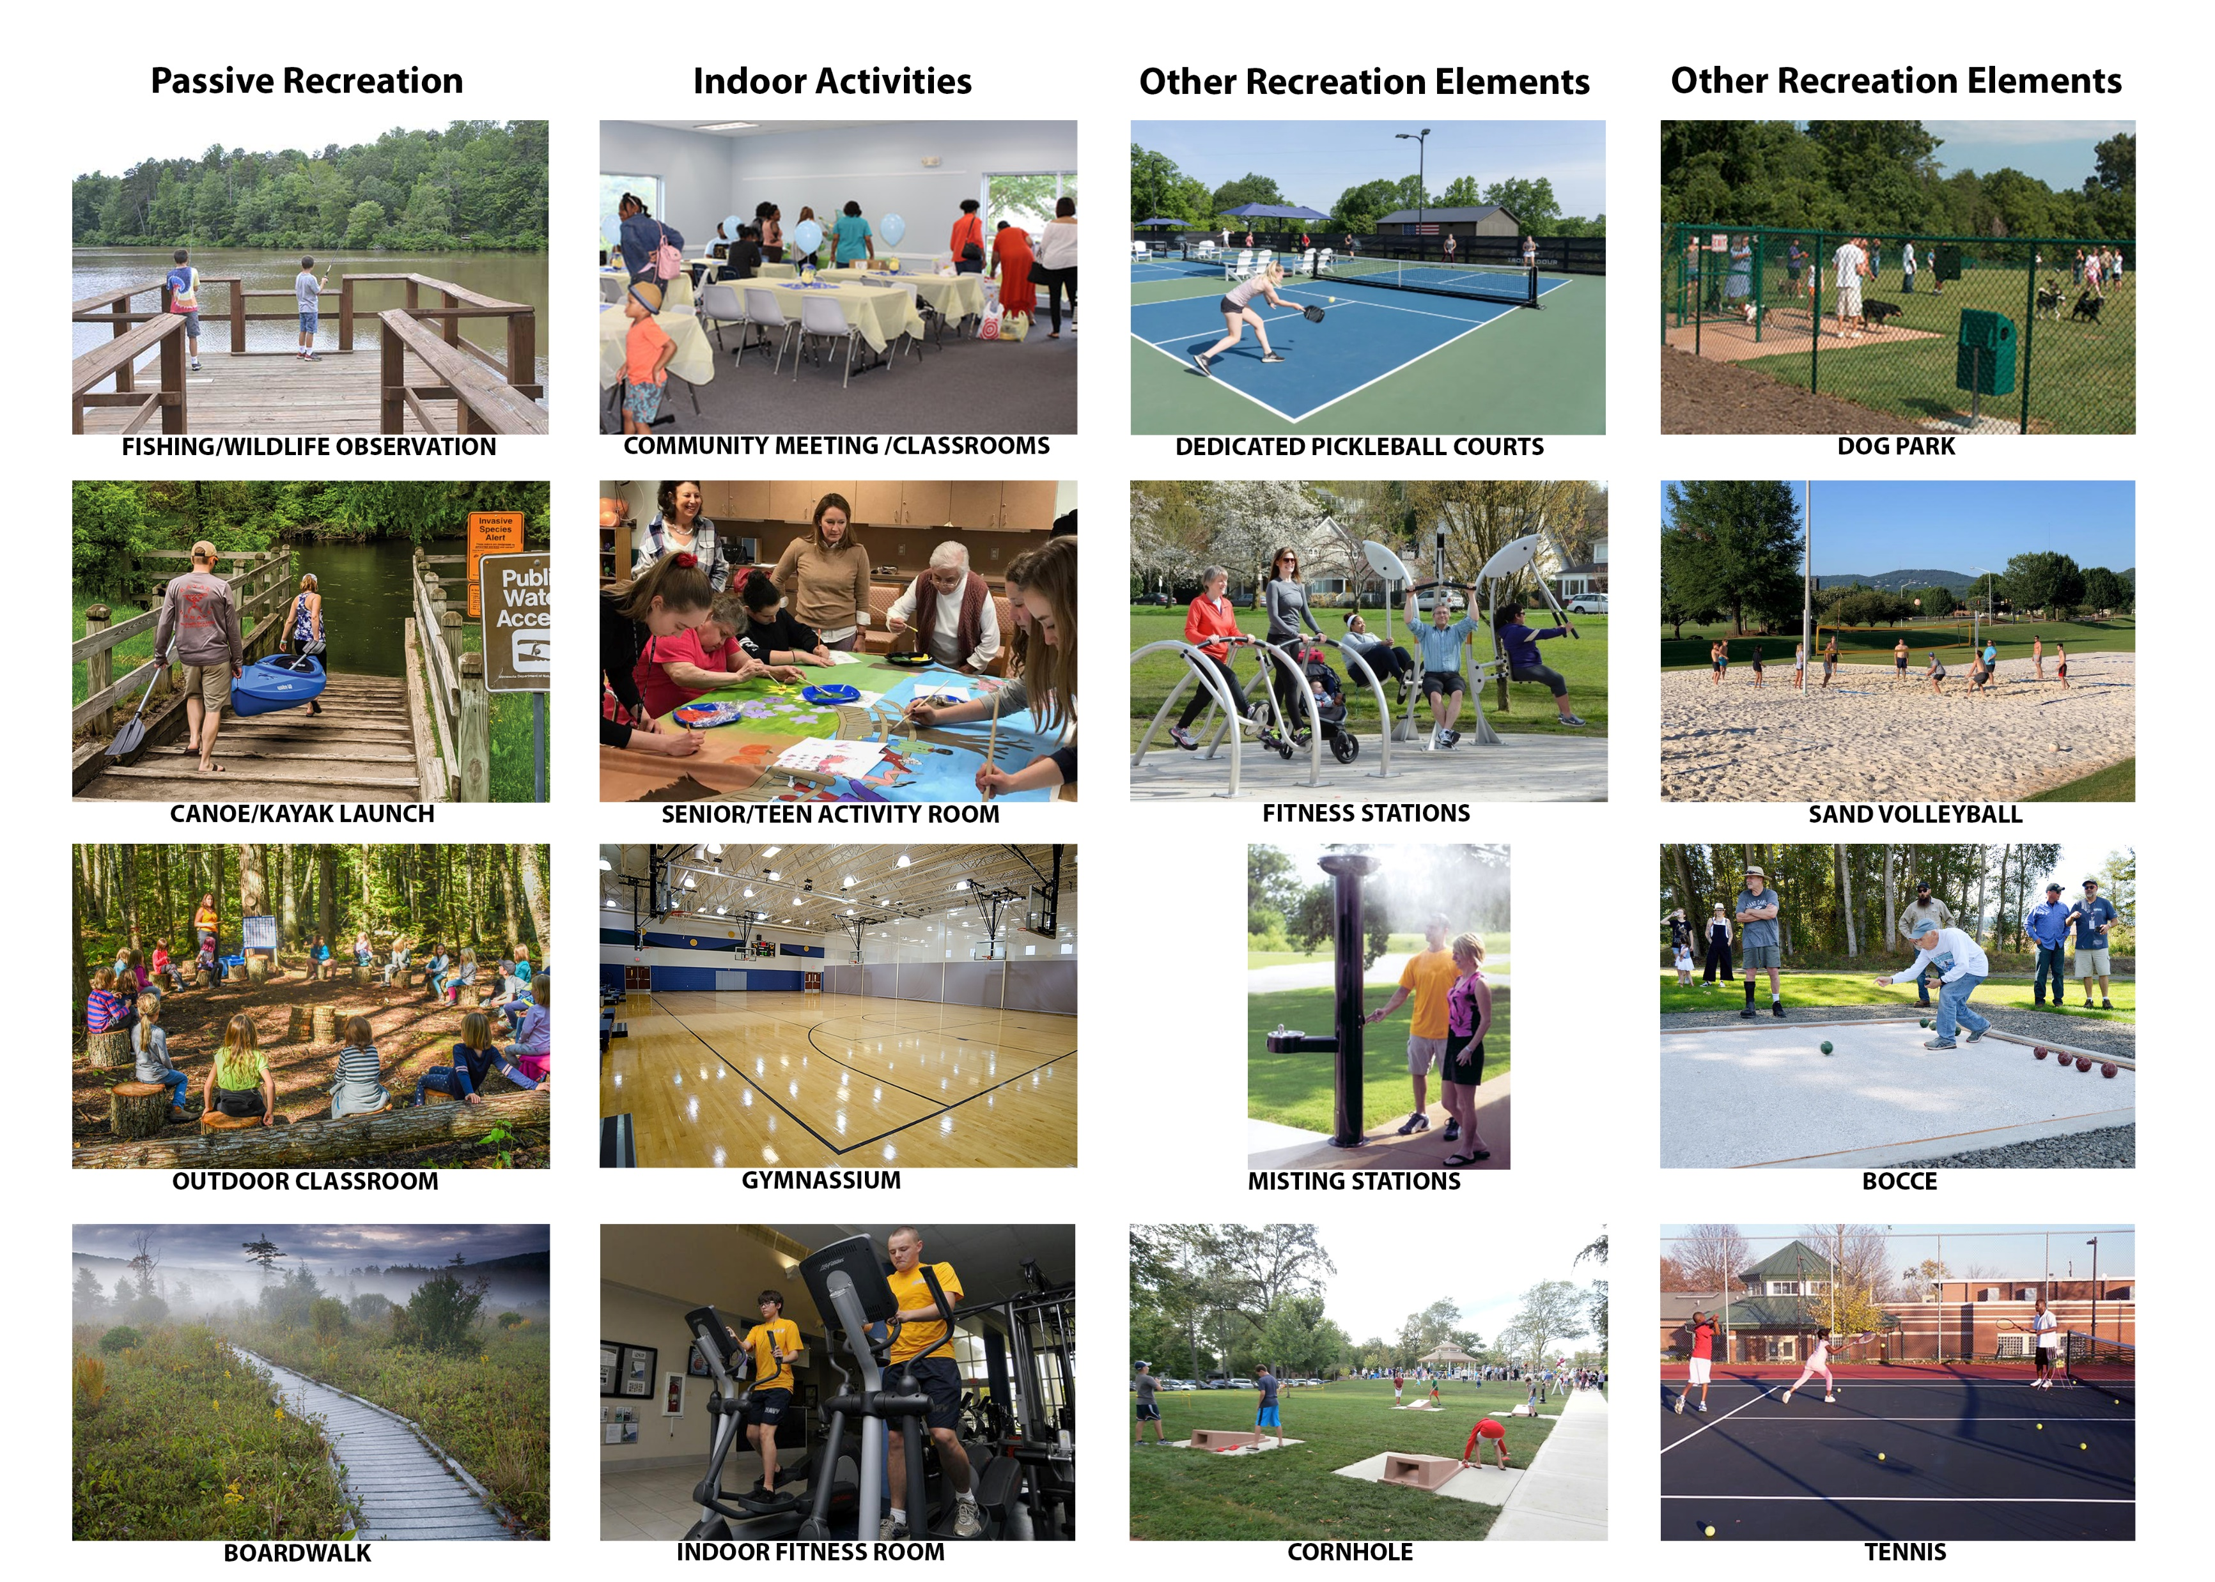
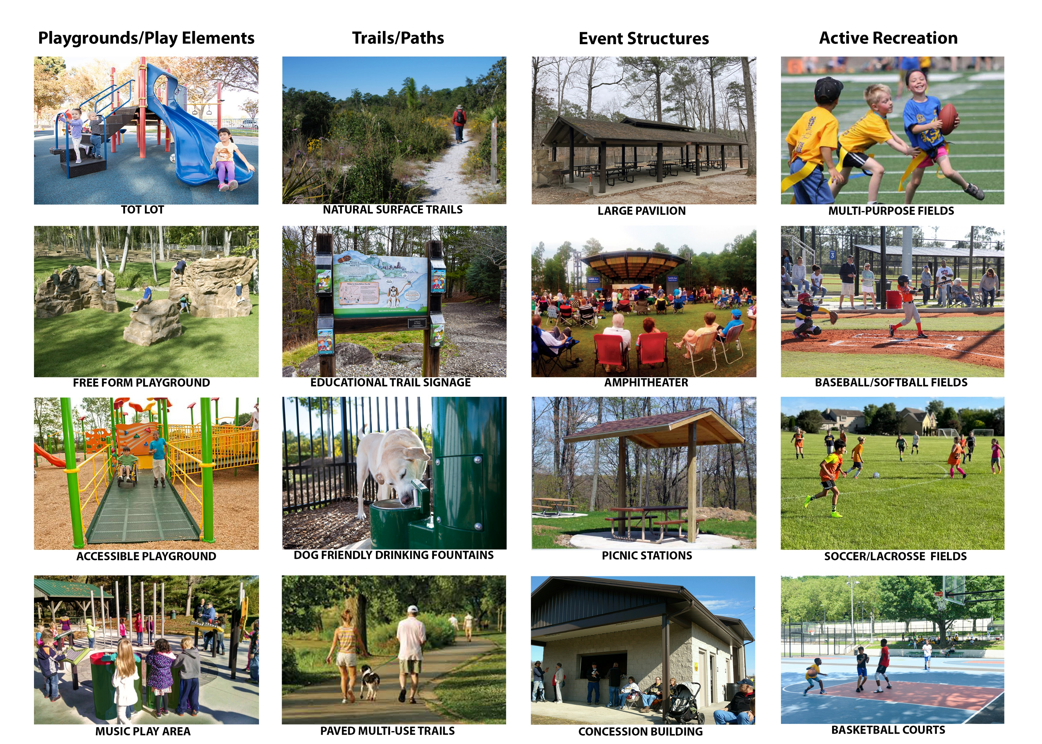
Visual Preference Survey Responses
Top 5 preferences from the public:
1. Write-in (Davidson Community Center) 45 votes
Amphitheater 34 votes
Dog Park 30 votes
4. Paved Multi-use Trails (tie) / Baseball/Softball Fields (tie) 20 votes each
Multi-purpose fields 16 votes
Notes:
This presentation has 3 parts:
--an introduction to comprehensive planning
--an overview of the process
--and discussion questions

Slide 18
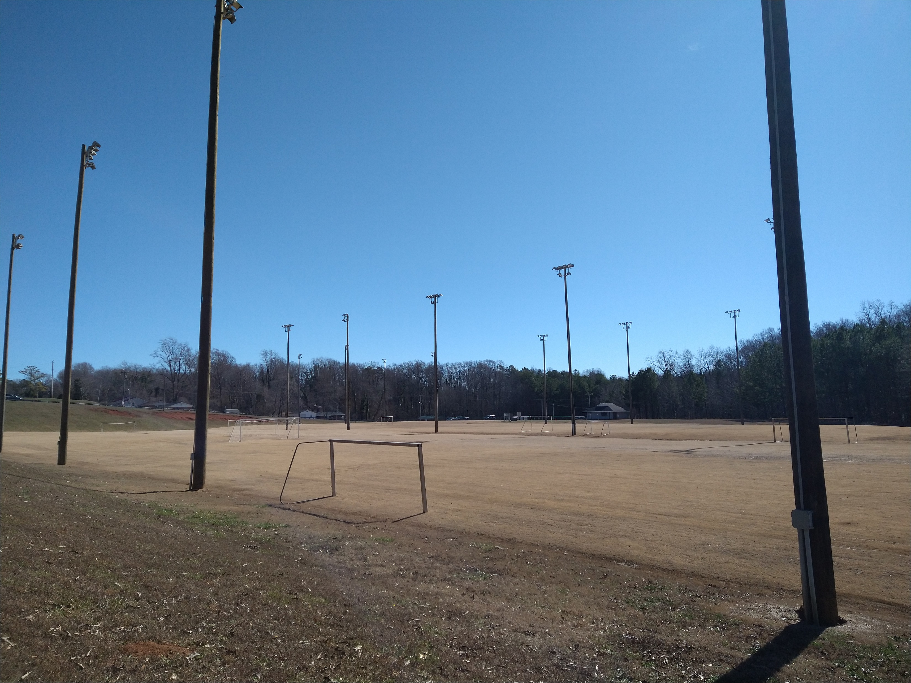
Focus Group Meetings - General Ideas and Concerns
Kings Mountain needs more athletic fields of all types, along with facilities to host tournaments
The public desires additional neighborhood park amenities such as walking paths, playgrounds, non-programmed open spaces, a dog park, neighborhood community centers
Kings Mountain has a growing population and should expand to meet resident demands
Recreation opportunities are not communicated well to the public
The YMCA is a valuable resource for Kings Mountain along with other not-for-profit organizations in the City
Patriot Park needs more seasonal events
Participants desire more neighborhood parks, community center programs for kids and teens
Lack of walkable recreation destinations hampers access to recreation for many residents
Investment in recreation is currently an untapped economic development asset.
Notes:
This presentation has 3 parts:
--an introduction to comprehensive planning
--an overview of the process
--and discussion questions

Slide 19
Highlights from Recommendations
Top 10 Recommendations
1. Re-establish Parks & Recreation Department
2. National Recreation & Parks Association (NRPA) Agency Accreditation
3. Existing Facility Improvements & Maintenance (Davidson, Moss Lake, Ramseur, Thombs, etc.)
4. New Facility Planning & Development (Multi-Sport Complex, Neighborhood Park, Farmer’s Market, etc.)
5. Walkable Communities & Greenways / Multiuse Trails
6. Expansion of Programs and Classes
7. Partnership Granting and Evaluation Process
8. Partnership Agreements Updated
9. Parks Department to Incorporate Current City Marketing and Branding
10. Intergovernmental Cooperation
Notes:
We will conduct virtual meetings, including some that offer live presentations along with live polling and chats.
Pre-recorded presentations, like this one, can be accompanied by brief surveys so we can share information and get the feedback we need.
But how do we reach folks who do not have internet access?
The City will utilize other means. For example, staff will reach out with paper surveys that can be mailed back to the City. Also, the City will encourage and facilitate the use of apps like Nextdoor and tap into public school and church communications.

Slide 20
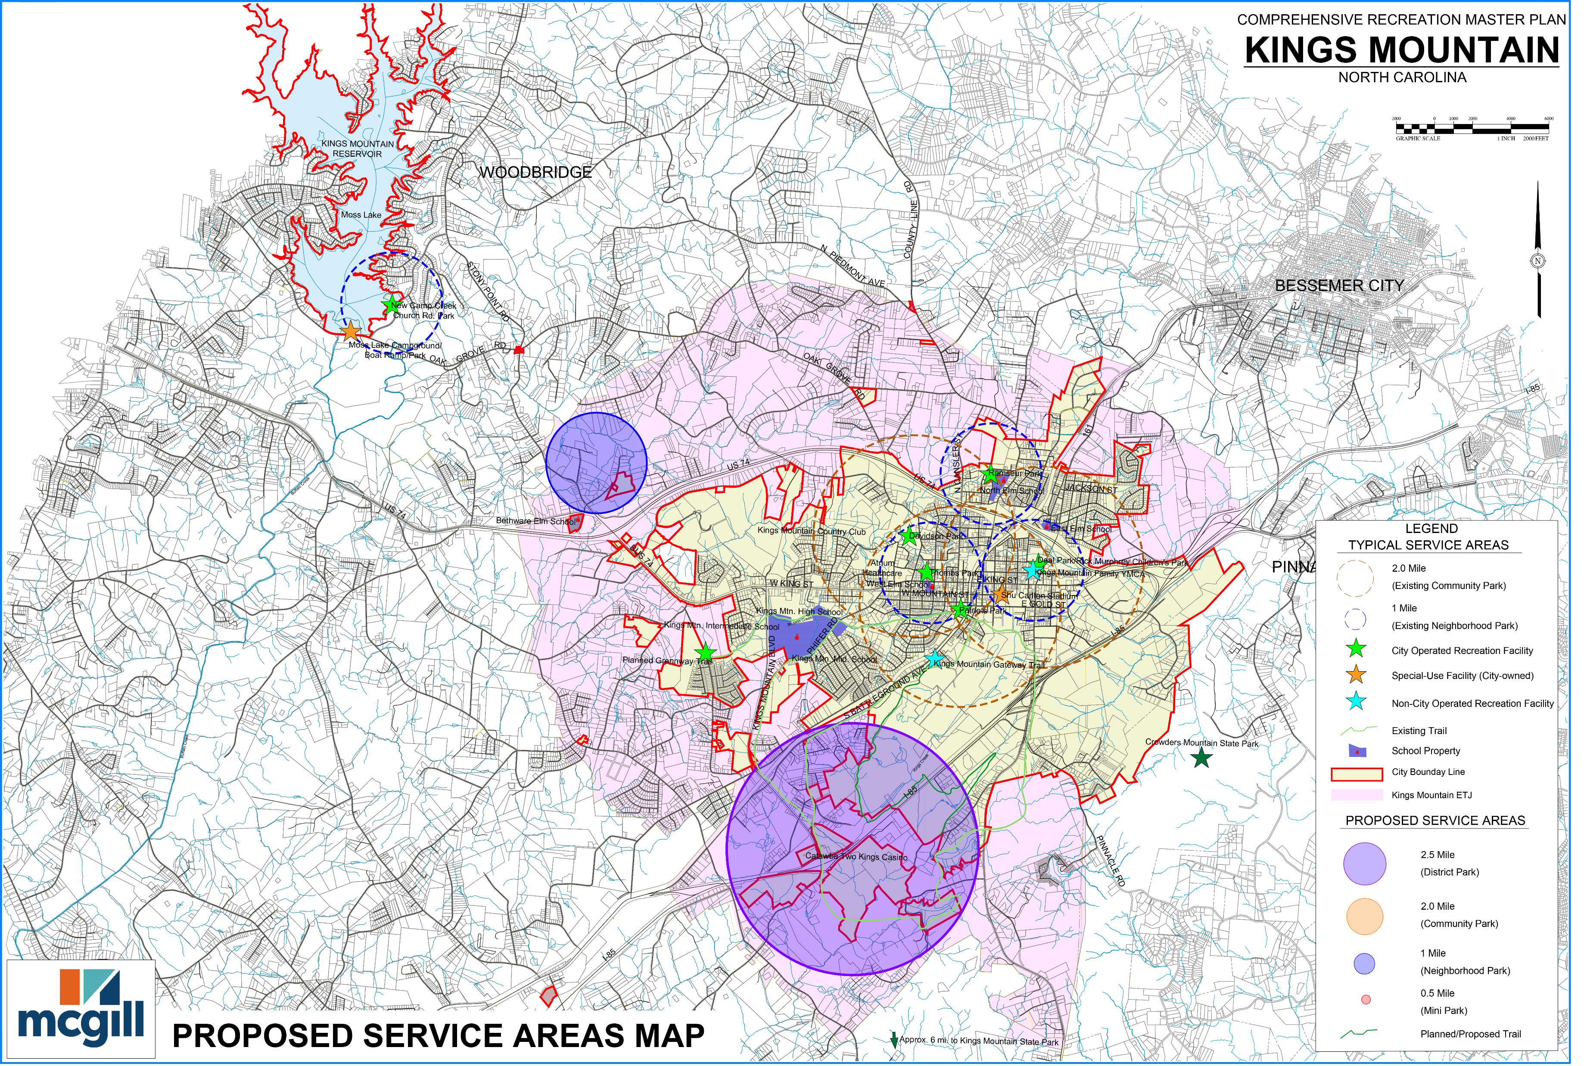
Notes:
We will conduct virtual meetings, including some that offer live presentations along with live polling and chats.
Pre-recorded presentations, like this one, can be accompanied by brief surveys so we can share information and get the feedback we need.
But how do we reach folks who do not have internet access?
The City will utilize other means. For example, staff will reach out with paper surveys that can be mailed back to the City. Also, the City will encourage and facilitate the use of apps like Nextdoor and tap into public school and church communications.

Slide 21

Recommendations
Strategic Organizational Needs
Re-establish a parks and recreation department | Expand recreation programs and classes
National parks and recreation agency accreditation | Partnership granting and evaluation process improvements
Existing facility improvements and maintenance | Update partnership agreements
Develop new facilities | Incorporate city marketing into the parks department
Improve walkability | Improve intergovernmental cooperation
Capital Needs (Highlights)
2024-2026
Moss Lake Improvements: Day use and trails
Davidson Park Improvements
LG Thombs Parks and Trail Improvements
2027-2030
Multi Sports complex
New Neighborhood Park (land acquisition)
Patriot Park Improvements
2031-2034
New Neighborhood Park (development)
Estimated capital needs of $30M over 10 years
Notes:
We will conduct virtual meetings, including some that offer live presentations along with live polling and chats.
Pre-recorded presentations, like this one, can be accompanied by brief surveys so we can share information and get the feedback we need.
But how do we reach folks who do not have internet access?
The City will utilize other means. For example, staff will reach out with paper surveys that can be mailed back to the City. Also, the City will encourage and facilitate the use of apps like Nextdoor and tap into public school and church communications.

Slide 22

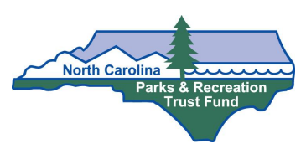
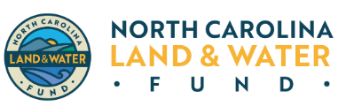

Leveraging Parks Funding Streams in North Carolina
Eligibility: Kings Mountain Is eligible for all of these funds
Partnering: Partnering with the County and other municipalities is possible. Non-profits are not typically eligible
Leveraging local funds: These grants are great ways to leverage local investments of funds.
Key considerations: Planning is critical in receiving all of these funds
Public Input: Public needs and wants are the backbone of justifying these funds to the funding body.
State Funds $500k Max | Federal Funds $500k Max | Federal Trails Funding | State Land Protection and Waterways
New North Carolina Park funds added this year.
Accessible Parks Grant
Great Trails State Funding

Slide 23
Questions?
Notes:
As we kick off this project, we’d like to get your thoughts! When the decision to move forward with an updated plan for the City was made, you probably had one or two key objectives of your own in mind. What were they? What are your expectations for the plan? What do you think it should do for the City?
And what does success look like? If you had to name one thing that should be true about the plan when it is done—or the City 10 years from now—to fully believe that this project was worth the effort, what would that be?

